Slide 1

Mid-term project for the course Distributed & Scalable Data Engineering (DSDE) - 6007-01
TEAM -1
Nihanth Kolluru
Sindhu Bhargavi Gajulapalli
Revanth Kumar Ghanta

Slide 2

Electronic Health Records(EHR) Management

Slide 3

Contents
Project overview
Business Understanding
Problem
The Approach
Data Understanding
Data preparation
Tools & Technologies
Modeling
Evaluation

Slide 4

Project overview
AIM : Developing a scalable architecture for managing Electronic Health Records (EHR) that complies with healthcare data regulations across countries.
This Photo by Unknown Author is licensed under CC BY

Slide 5

Business Understanding
Healthcare industry collects large volumes of sensitive data (EHR) . This data should be ensured with security and complies with regulations.
Managing huge amounts of sensitive healthcare data is critical for ensuring operational efficiency, improving patient healthcare.
Healthcare providers, research organizations need a secure scalable and compliant data architecture to store manage and analyze healthcare data .

Slide 6
Problem
Managing the vast volumes of electronic health records(EHR) is a complex challenge due to the sensitive nature of the data.
Healthcare organization must not only store and process , but also ensure strict compliance with regulatory frameworks such as HIPAA, GDPR and other global standards.
The current systems often struggle with inefficiencies, high costs , and vulnerabilities in handling sensitive patient information at scale.

Slide 7
The Approach
To address these challenges, we will develop a scalable cloud-based data architecture for managing EHR data.
This architecture will include an automated ETL pipeline to ingest, clean, and transform medical records from multiple sources. Data will be securely stored in a cloud storage system, with a data warehouse (such as Snowflake or Redshift) for easy querying and analysis.
Compliance with healthcare regulations will be ensured by applying de-identification techniques, encryption, and access controls, with Apache Airflow orchestrating the ETL tasks to ensure efficiency and reliability.

Slide 8

Data understanding
The objective of managing Electronic Health Records (EHR) in compliance with regulations like HIPAA, it's essential to have a clear understanding of the type of data involved and its structure. EHR data typically includes :
Patient Information : Personal details like name, age, gender, address, and medical history.
Clinical Data : Diagnoses, medications, treatments, lab results, and imaging records.

Slide 9
Data Preparation
Before implementing the system, the following steps are required for preparing the data:
Data Collection :
Collect EHR data from simulated sources or open-source datasets (like MIMIC-III).
Ensure data consistency by cleaning missing, duplicate, or erroneous entries.
Data Cleaning :
Remove duplicates and normalize patient records (e.g., by merging records with the same patient ID).
Correct data inconsistencies, such as conflicting medical history or incorrect personal details.

Slide 10
Tools and Technologies
AWS S3 - Amazon S3 or Amazon Simple Storage service is a service offered by Amazon Web Services that provides object storage through a web service interface .
AWS Lambda - AWS Lambda is an event-driven ,serverless computing platform provided by amazon as a part of Amazon Web Services .
AWS Redshift - Amazon Redshift is a data warehouse product which forms part of the large cloud-computing platform Amazon Web Services .
AWS GLUE – AWS Glue is a fully managed ETL (Extract, Transform, Load) service by Amazon Web Services (AWS) that helps you prepare and move data between different data sources.
Python 3.10
Pandas - Pandas is a software library written for the python programming language for data manipulation and analysis .
Power BI - Power Bi is an interactive data visualization software product developed by Microsoft with a primary focus on business intelligence.

Slide 11
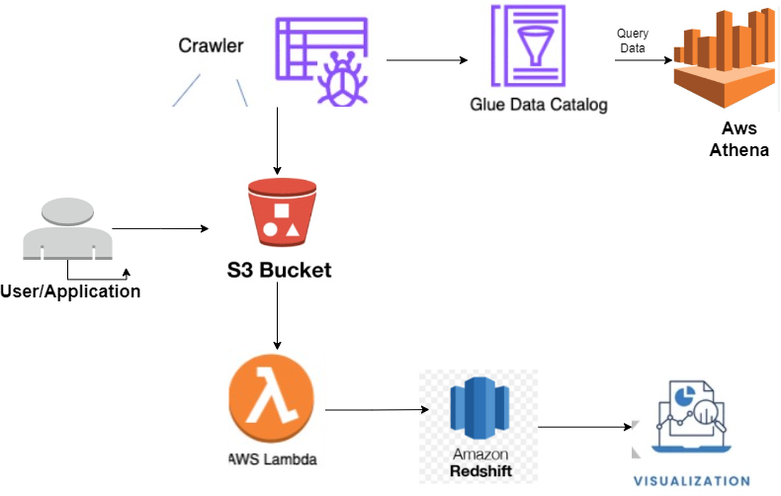
Modelling

Slide 12
Evaluation
CSV files will be loaded into s3 buckets from the source, to make it real time the data directly either from API or from normal data sources
AWS Glue will be setup with respect to the designated bucket to setup AWS Athena by using AWS Glue Crawler and AWS Glue Catalog
Lambda function triggers to cleanse i.e., Perform ETL operations
The cleaned data is then loaded into Amazon RedShift warehouse to store huge amounts of data.
The data in warehouse is then used for visualizing tends, for data scientists to predict the readmission of patients, disease prediction.
The data can be loaded into AWS Healthlake (FHIR service)

Slide 13

Links
Github : https://github.com/NihanthK7/DSDE
Youtube : https://youtu.be/xQjGX3NnpRc?si=SL3s3-X_KcLZ9lFi

Slide 14

THANK YOU

